Slide 1
Vehicle Identification
Harsh Patel
Jill Hughes
Logan Murphy
Mihai Anghel

Slide 2
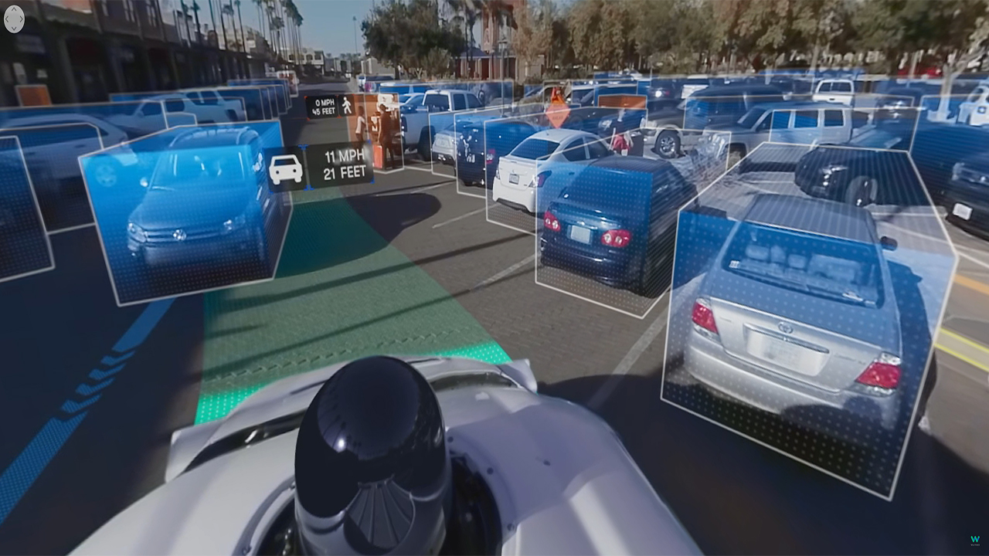
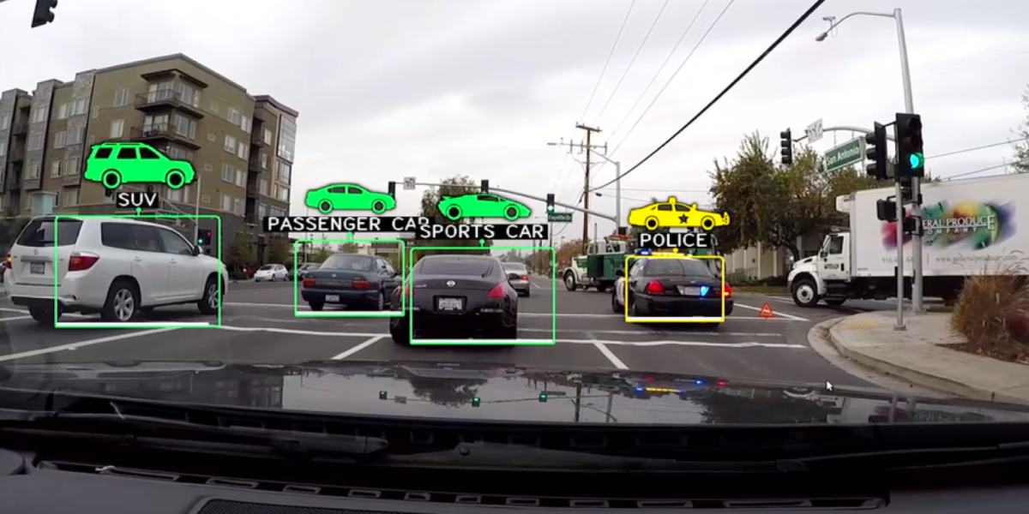
Model for Vehicle Image Recognition
Why choose this topic? Our team decided to pursue this topic for the various versatile utilizations a model such as this could have on a number of different transportation applications. Applications such as monitoring traffic flow, automated parking systems and support for traffic law enforcement could integrate this machine learning model into their product to increase efficiency and results per their requirements.
Notes:
Rubric: Selected topic ✔️
Reason why they selected their topic ✔️
Images: https://content.fortune.com/wp-content/uploads/2015/10/screen-shot-2015-10-15-at-8-04-48-pm.png?resize=1200,600
https://www.altoros.com/blog/wp-content/uploads/2018/06/TensorFlow-Deep-Learning-Artificial-Intelligence-Machine-Learning-Waymo-360-sensors.jpg

Slide 3
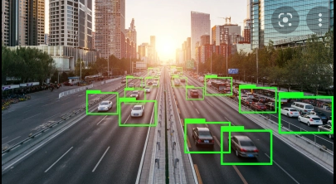
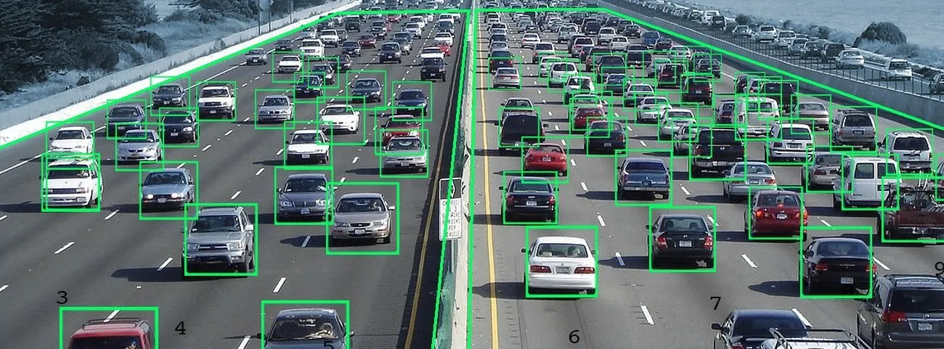
Our Data
Our data source offers 16,185 images of 196 classes of cars. These are split between 8,144 training & 8,041 testing images, each class has been roughly 50-50 split.
The classes are at the level of Make, Model, Year Ex: 2012 Tesla Model S or 2021 BMW M3 coupe
Citation: 3D Object Representations for Fine-Grained Categorization Jonathan Krause, Michael Stark, Jia Deng, Li Fei-Fei 4th IEEE Workshop on 3D Representation and Recognition, at ICCV 2013 (3dRR-13). Sydney, Australia. Dec. 8, 2013. Source: Stanford.edu ~jkrause Dataset
Notes:
Rubric: Description of their source of data ✔️
Images:
https://viso.ai/wp-content/uploads/2021/05/deep-learning-vehicle-detection-video-analytics.jpg
https://venturebeat.com/2019/10/28/how-ai-is-impacting-the-automotive-world/.

Slide 4

The primary question our team hopes to answer throughout the project:
Can we take a dataset containing thousands of images, and create a model using machine learning in order to identify whether or not a vehicle is present in an image?
Notes:
Rubric: Question(s) they hope to answer with the data ✔️ Image: https://www.forbes.com/sites/jarretjackson/2020/08/12/as-a-leader-are-you-asking-the-right-questions/?sh=5bba78826e7d

Slide 5
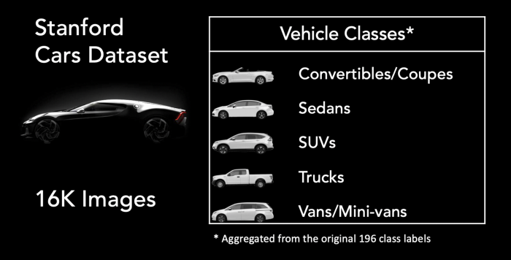
The second question our team hopes to answer throughout the project:
Can the our prototype machine learning model identify the make, model and year of a targeted vehicle in an image?
Notes:
Rubric: Question(s) they hope to answer with the data ✔️
Image: https://towardsdatascience.com/classifying-car-images-using-features-extracted-from-pre-trained-neural-networks-39692e445a14

Slide 6
Data Exploration
The Challenge
Unlike previous datasets we’ve encountered that were in CSV or Panda formats, this time our data came in MatLab format. The team had to find a way and transform this format into Pandas DataFrames. This would:
Allow its introduction into the AWS database
Allow effective use by our neural network model to process the images in an accurate and timely manner
The following outline explains the steps taken in order to clean, organize and set up our datasource that it can be used for analysis in our model
Data Preparation Outline
Choose Data Source Stanford Dataset
Process Matlab Files
Pandas DataFrame Creation
Create AWS Buckets Data Image Storage
AWS PostgreSQL Table Creation & Population
Dataset chosen for project presented here
Labels, df_train, df_test
Upload images to AWS buckets from PC using R3 Upload Tool
Creating and populating the tables to be used to run the Train/Test Machine Model
Notes:
Rubric: Description of the data exploration phase of the project ✔️

Slide 7

Analysis Phase (Part 1)
Initial Analysis
Pandas was used to clean raw data from initial Matlab format
Further analysis conducted with Python
PostgreSQL Database: How do we connect our data to the model?
Read in database and create dataframe
Query merging images
Import dataset into model through query merging
Images evaluated to determine what features will be captured
Hosted on AWS
AWS R3 Storage Buckets
Training images
Testing images
Notes:
Rubric:
Description of the analysis phase of the project ✔️
Image: https://www.vectorstock.com/royalty-free-vector/to-do-list-icon-checklist-task-list-vector-19800745

Slide 8
Analysis Phase (Part 2 - Machine Learning Model)
Sequential (model)
Hidden layers with activation set to reLu
Using optimizer adam and accuracy metrics
SciKit Learn
ML library for creating classifier
Neural Networks
Popular choice for image processing in machine learning models
Other choices included a Random Forest Classifier ML model
More consistent concerning image classification
More flexible for feature processing
Tested using cleaned data
Query merging images
IMport dataset into model through query merging
Images evaluated to determine what features will be captured
AWS R3 Storage Buckets
Training images
Testing images
Two major packages/applications to consider: Tensorflow vs. Pytorch
Both are successful image classifiers
Tensorflow was the familiar choice
Used to test Neural Networks Model
Put it into practice
Read database and create dataframe
Test model
Update test image class & evaluate accuracy
How was data split into testing and training datasets?
50/50 split
Adjusted as needed for the addition of future models
Notes:
Rubric:
Description of the analysis phase of the project ✔️

Slide 9
Looking ahead for final presentation…
Flask Application
Created using pickle file of model
Final deployed application will take an uploaded image and return: vehicle/ not vehicle
D3.js
Fully functioning, interactive dashboard
Tableau
Final deliverable
Application hosted on Amazon Web Services

Slide 10
Tableau Blueprint
Open with brief overview of process, database, and model
Focus on README with link
User input and results
A brief look at future plans.
Feedback

